Slide 1


Alabama Department of Revenue – City and County Motor Fuel Single Point Filing and Payment System

Slide 2
What is the Motor Fuel Single Point System?
Alabama Department of Revenue
Alabama Department of Revenue
MOTOR FUEL SINGLE POINT FILING AND PAYMENT SYSTEM
Act 2018-469 – Effective 5/1/18
Requires the Revenue Department to develop a system where the taxpayers can timely file and pay county or municipal motor fuel excise taxes electronically through a single point at no charge to the taxpayer or local taxing jurisdiction
System is being designed by Fast Enterprises (RITS) and Alabama Interactive
Taxpayers are not required to use the Motor Fuel Single Point System

Slide 3
Timeline
5/1/2019 Locals must submit a list of the Motor Fuel taxes levied by jurisdiction (per gallon basis only)
6/30/2019 Locals must provide ADOR with bank information
9/3/2019 Taxpayers can request SPF (Single Point Fuel) Account for filing purposes
10/31/2019 Motor Fuel Single Point System will be available
11/1/2019 Taxpayers may start filing returns for periods October 2019 or later
Alabama Department of Revenue
MOTOR FUEL SINGLE POINT FILING AND PAYMENT SYSTEM
Alabama Department of Revenue

Slide 4
Local Requirements
Alabama Department of Revenue
Alabama Department of Revenue
MOTOR FUEL SINGLE POINT FILING AND PAYMENT SYSTEM
Local motor fuel rates were due by 5/1/2019
  All localities have informed ADOR of their local rates.
Local banking information was due by 6/30/2019
  Must be able to receive payments
  Must be able to allow dishonored payments to be reversed
  Payments for non-state administered locals shall be remitted directly from the taxpayer to the designated account
  Of those who have indicated a tax, 7 have not provided this information
    If not provided, localities will not receive tax payments submitted through the Single Point System

Slide 5
Local Requirements
Alabama Department of Revenue
Alabama Department of Revenue
MOTOR FUEL SINGLE POINT FILING AND PAYMENT SYSTEM
Must provide ADOR with a 60-day notice prior to any additional or amended rates being available on the single point system
For reporting access, the locality must provide the Motor Fuels Section with a Nonemployee Confidentiality and Disclosure Statement for all employees and third-party administrators requiring access
  A separate disclosure form for each tax type is required to be completed for access to confidential information

Slide 6
Local Information – Reminder
Alabama Department of Revenue
Alabama Department of Revenue
MOTOR FUEL SINGLE POINT FILING AND PAYMENT SYSTEM
  If you have a local gas or motor fuel tax and have not received an email from Dana Thomas to indicate that you have submitted all required documentation, please reach out to the Motor Fuels Section to determine what documents are required. If ADOR has not received all required documentation, this could cause a delay in the processing of returns and payments as well as providing reporting information to your locality.

Slide 7
Local Reporting
Alabama Department of Revenue
Alabama Department of Revenue
MOTOR FUEL SINGLE POINT FILING AND PAYMENT SYSTEM
Localities will have the ability to query and export reports from disbursements
  Using the same site as One-Spot, WRAP, and Local Tax Reports
Daily File Download
  Returns: Detail data for daily disbursement
  Payments: Detail data for daily confirmed payments
  Debits: Detail data for returned payments
Query Data
  Taxpayer data
  Detail data for each end user/store

Slide 8
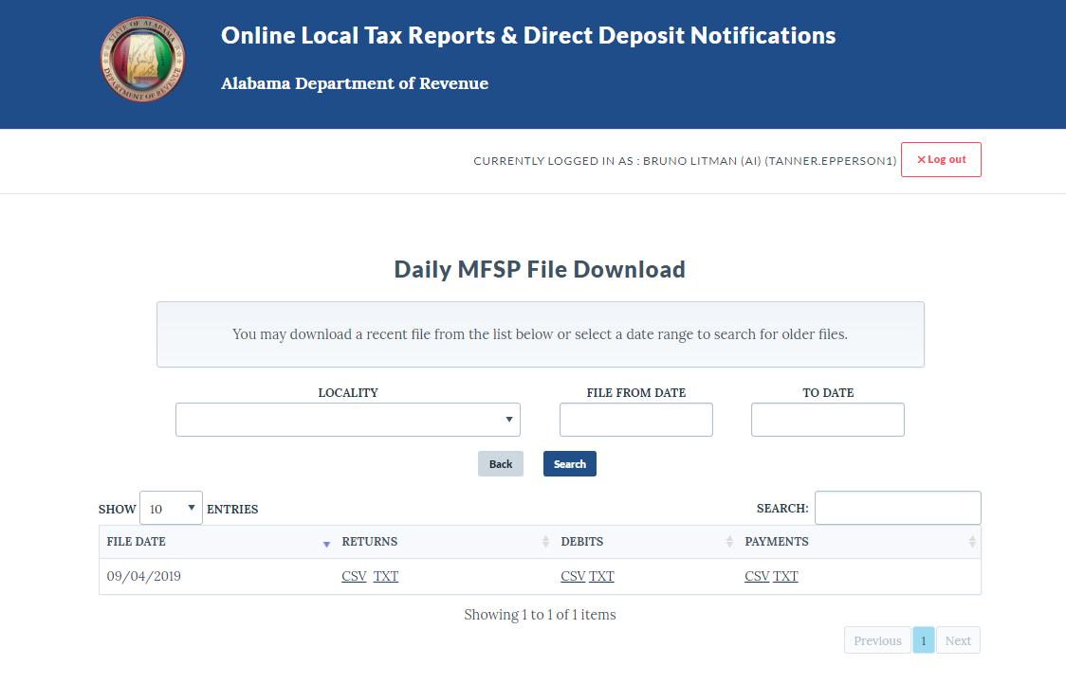
Local Reporting – Daily Download
Alabama Department of Revenue
Alabama Department of Revenue
MOTOR FUEL SINGLE POINT FILING AND PAYMENT SYSTEM

Slide 9
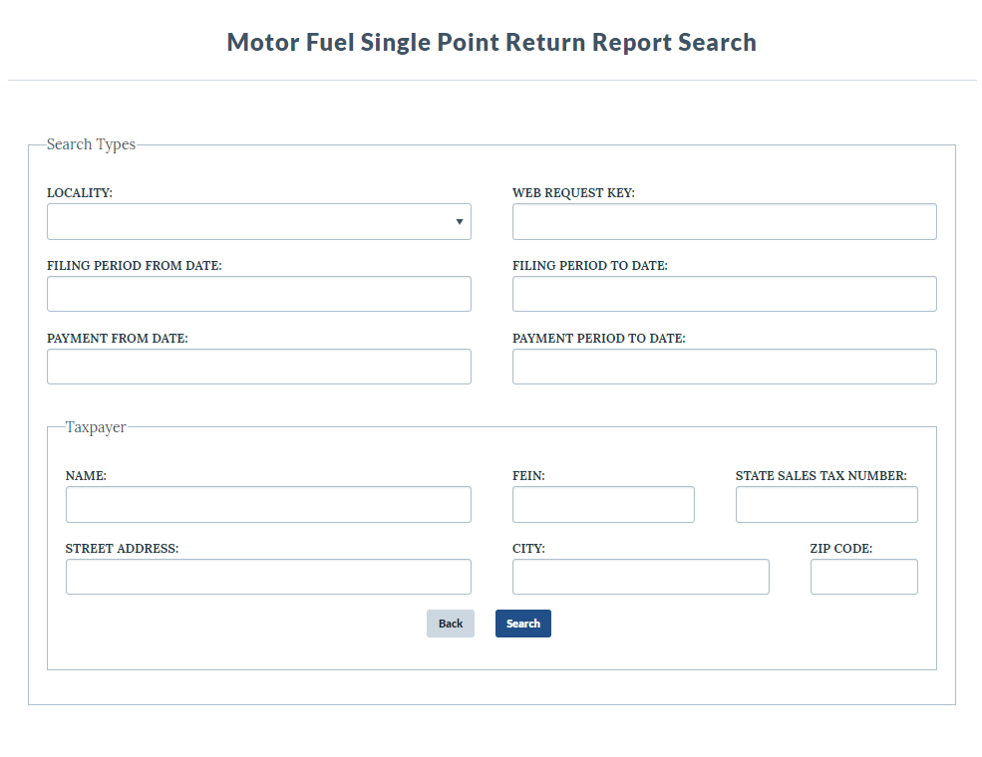
Local Reporting – Return Report Search
Alabama Department of Revenue
Alabama Department of Revenue
MOTOR FUEL SINGLE POINT FILING AND PAYMENT SYSTEM

Slide 10
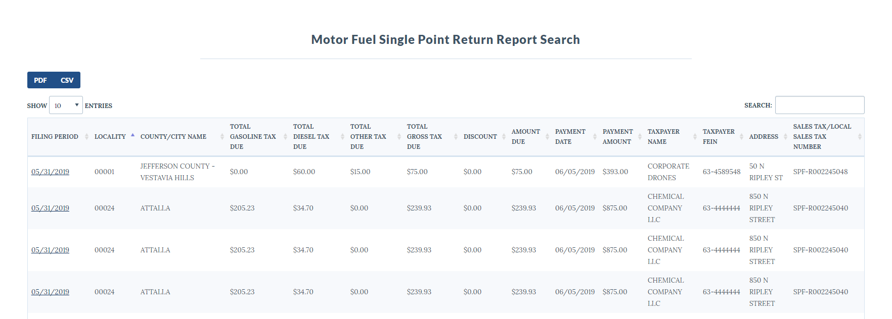
Local Reporting – Return Report Data
Alabama Department of Revenue
Alabama Department of Revenue
MOTOR FUEL SINGLE POINT FILING AND PAYMENT SYSTEM
Selecting the filing period will display detail information

Slide 11
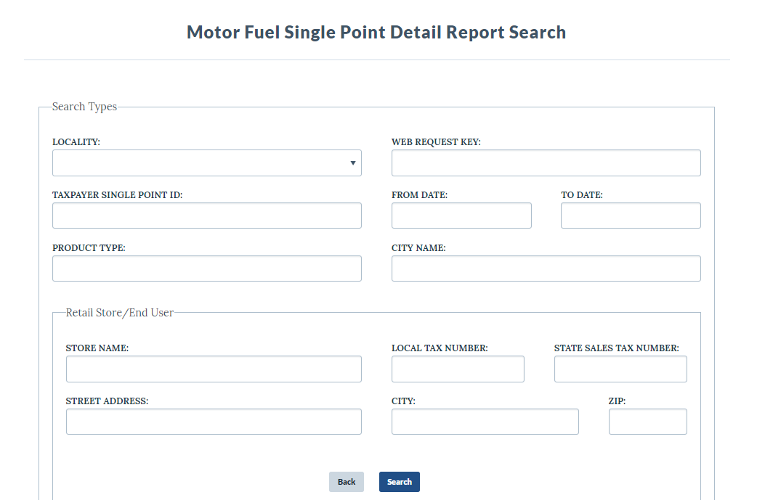
Local Reporting – Detail Report Search
Alabama Department of Revenue
Alabama Department of Revenue
MOTOR FUEL SINGLE POINT FILING AND PAYMENT SYSTEM

Slide 12
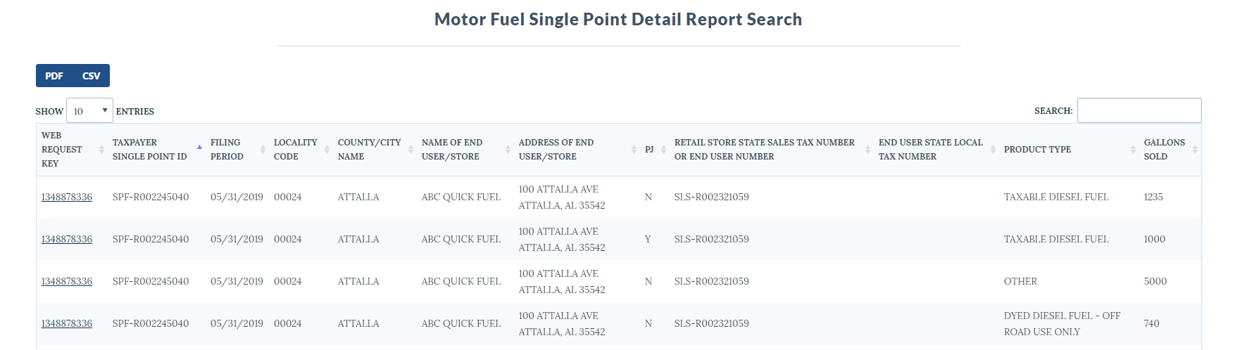
Local Reporting – Detail Report Data
Alabama Department of Revenue
Alabama Department of Revenue
MOTOR FUEL SINGLE POINT FILING AND PAYMENT SYSTEM
Selecting the web request key will display return information

Slide 13
ADOR Requirements
Alabama Department of Revenue
Alabama Department of Revenue
MOTOR FUEL SINGLE POINT FILING AND PAYMENT SYSTEM
Develop the Motor Fuel Single Point System
Act as a conduit only for payments
  As ADOR is a conduit only, we have provided the taxpayers with a contact number for the localities as provided to the Motor Fuels Section via the template in case of questions relating to tax administration
Make return information electronically available to locals without delay
Provide a monthly report:
  Name/address of taxpayer
  Number of gallons sold
  Amount of tax remitted
At this time, the localities should have received communication from Tanner Epperson with Alabama Interactive regarding test files

Slide 14
Taxpayer Requirements
Alabama Department of Revenue
Alabama Department of Revenue
MOTOR FUEL SINGLE POINT FILING AND PAYMENT SYSTEM
Taxpayers must submit both the return and payment at the same time
Must submit return by the 20th of the month succeeding the month of activity
No late returns or amended returns will be accepted via the system
  Late returns and payments must be made directly to the local taxing jurisdiction or designated agency
No refunds may be processed via the system
Return must include:
  Name of store
  Physical address of store
  Sales tax number of store
  Number of taxable gallons received
  Local excise tax paid
  Other information as required

Slide 15
Taxpayer Resources
Alabama Department of Revenue
Alabama Department of Revenue
MOTOR FUEL SINGLE POINT FILING AND PAYMENT SYSTEM
  https://revenue.alabama.gov/business-license/motor-fuels/
  By visiting the above website, taxpayers can find a report listing all current local motor fuel rates, historical data on local motor fuel rates, as well as information relating to Single Point and video tutorials on how to acquire an account and file a return.

Slide 16
Contact Information
Alabama Department of Revenue
Alabama Department of Revenue
MOTOR FUEL SINGLE POINT FILING AND PAYMENT SYSTEM
Business & License Tax Division
Motor Fuels Section
P O Box 327540
Montgomery, AL 36132-7540
Telephone: (334) 242-9608, option 6, option 6
Fax: (334) 242-1199
E-mail: mft@revenue.alabama.gov

